Slide 1
Computer Science
Mr. Eddie

Slide 2
Agenda

Slide 3

Agenda
Do Now
Objectives
Reflection
Work Time
Reflection + Feedback
Exit Ticket

Slide 4

Do Now
Answer the following questions:
Google Classroom
Answer the following question:
Why do you think taking the time to reflect on your learning is important?
(2-3 complete sentences)

Slide 5
Unit 2
U2.L3 - Summing up Basic HTML with CSS

Slide 6
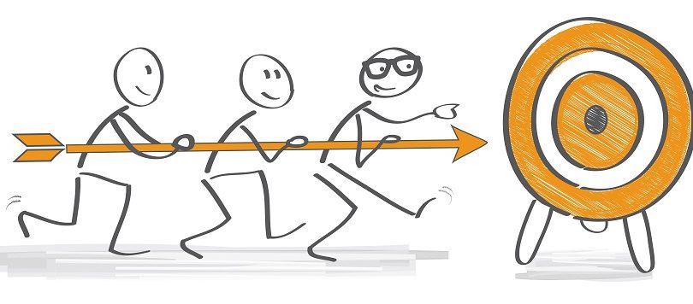
Objectives
Students reflect on learning experience.
Students work on updating their website to incorporate a Home Page.
Students submit the link to their portfolio reflection, via Google Classroom for grading, review and feedback.

Slide 7
Sentence Starters
I am proud of the…
Something I need to focus on is…
An Area of focus for me would be…
Something I commit to…
Some of my strengths are…
In Case You Need Them

Slide 8
Exit Ticket

